Slide 1
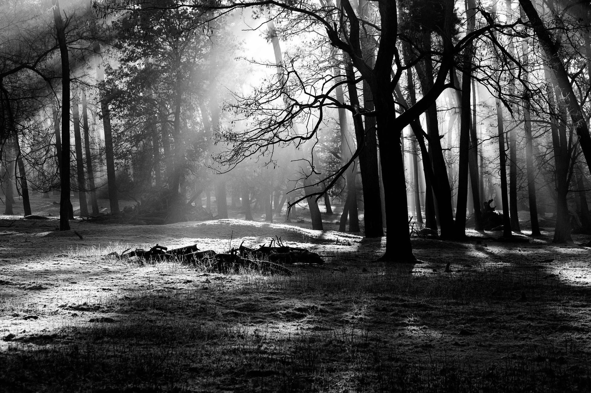
Shoot Your Shot
Anytime,
Everywhere.
I
SYS (Shoot Your Shot) photo app is an app aim to provide photographers a better way to take pictures that can include more details in it.
Easy, convenient and quality.
Unique, useful features all in one. No need to download many many apps and worry about the quality of photo would be ruined anymore.
With this app,
You can easily Take a Photo that Tells Stories.
Created by:
Brett Heithold, Minrui Huang, Brian Lee, and Xietong Wei

Slide 2

FEATURES

Slide 3







List of Feature
User login and logout
Real time location record
View and edit EXIF information
Weather information
Camera gear management
Camera setting calculator
Celestial event

Slide 4

Real time location record
Record GPS location when turned on.
Help photographer to sync the image GPS location during post processing
User can download GPS information though app

Slide 5



Camera Setting calculator
CONVERT THE APERTURE, FOCAL LENGTH BETWEEN DIFFERENT FORMAT(I.E APSC TO FULL FRAME. PHONE SENSOR TO APSC AND SO ON)
CALCULATE THE SHUTTER SPEED YOU SHOULD BE AT BULB SETTING WITH EXPOSURE COMPENSATION
CALCULATE THE MAXIMUM SHUTTER SPEED RECOMMEND FOR ASTROPHOTOGRAPHY BASE ON THE FOCAL LENGTH AND CAMERA FORMAT
CALCULATE THE RECOMMEND SHUTTER SPEED FOR TAKING HANDHELD BASE ON THE FOCAL LENGTH AND CAMERA FORMAT

Slide 6

COMPARISON

Slide 7

The Similar app
Instagram focuses on sharing of the pictures and videos.
People can use various filters on their photos.

Slide 8

Our SYS Photo App Comparison
The powerful and convenient tools for professional photographers and amateur photographers.
Camera Gear Management and Camera Setting Calculator
The App with weather information and celestial event reminder helps users to get high quality photos and study the knowledge of camera.
It is a useful app.

Slide 9
Significance
A tool for photographers
Combines many different functionalities into a single application
Allows photographer to quickly and easily access relevant information
Take better, more consistent photographs

Slide 10
Challenges
Little experience in Java
No experience developing for Andoid
Learning the different APIs needed
Google Maps for geolocation
Google Weather or Accuweather
Working with the EXIF data

Slide 11
Questions?

